Slide 1
Connecting Themes in
Social Studies

Slide 2
Conflict & Change
When there is conflict within or between societies, change is the result.

Slide 3
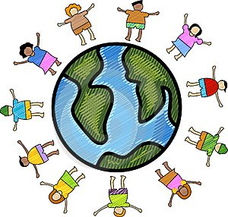
Culture
The culture of a society is the product of the religion, beliefs, customs, traditions, and government of that society.

Slide 4
Gain from Trade
People trade voluntarily when they expect to gain.

Slide 5
The rest will be available in the purchased version of the website.

